Slide 1
Where do the magic numbers come from?
The signal in the input data

Slide 2
The assessment model in mathematical terms

Slide 3
Another way of putting it:
We have:
Relative measures of stock abundance (Uay)
Absolute measures of removals from the stock (Cay)
We want:
Absolute numbers of the stock (Nay)
Removals relative to stock abundance (Fay)
But where does the model pick up the information on Nay and Fay from the measurements?

Slide 4
Signals in the catch data: The absolute value
The catch data are the only data that contain any absolute information (millions of fish caught)
Thus the absolute numbers in the stock (Nay) must come from the catches
But accuracy hinges on:
That the natural mortality is reasonable close to reality
That the catch data do not deviate too much from what is actually removed from the fisheries
However:
The advice may be fair, if the deviations are consistent in time

Slide 5
Signals in the catch data: The total mortality 1
The stock equation is:
Taking a logarithm gives
Thus, we do not need an absolute estimate of abundance, only the relative abundance of each from one age group to the next

Slide 6
Signals in the catch data: The total mortality 2
The math:
If there has been no change in effort over time or in catchability by age/size one can use the log ratio of the number of fish caught at each stage to estimate the total mortality.
This derivation show that if we have some measurement of catches by age (or length) we can estimate Z.
E: Effort
q: Catchability

Slide 7
Another way of putting it:
If we assume that F=qE we can show that:
Thus, the log catch ratio:
Contains the whole mortality information and nothing else
Can give us some ideas about the order of the total mortalities, but is modified by changes in fishing mortalities

Slide 8
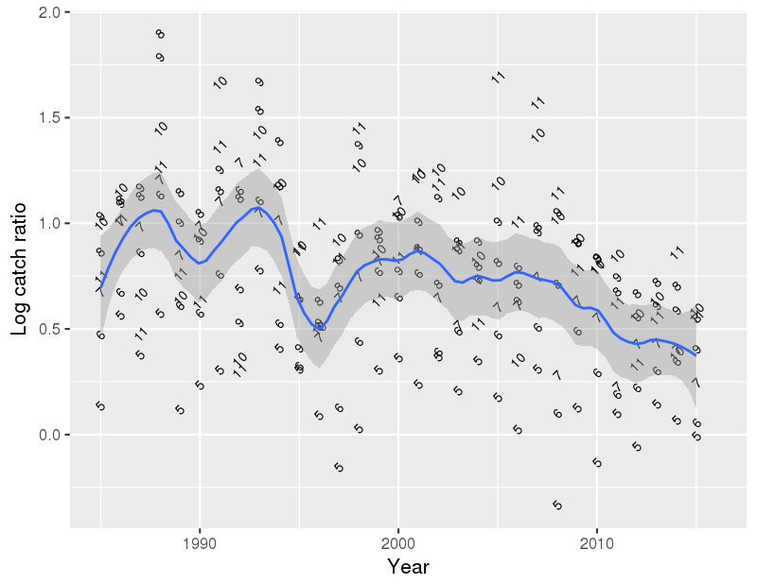
iCod: Log catch ratios by each age group

Slide 9
The catch development of ONE cohort
Decline in older ages a true measure of Z if qa does not change with age and if Fa does not change with time
Younger fish less available
(qa changes with age)
Catch in each age (time) class

Slide 10
Total mortality signal of older fish: Part 1
iHaddock
1990 year class
Catch in numbers (Ca,y)
year

Slide 11
Total mortality signal of older fish: Part 2
iHaddock
Logarithmic scale
1990 year class
Catch in numbers (Ca,y)
year

Slide 12
Total mortality signal of older fish: Part 3
iHaddock
Catch curve analysis
Catch in numbers (Ca,y)
Z = 0.48 (38%)
year

Slide 13
Total mortality signal of older fish: Part 4
iHaddock
90
92
89
88
91
87
Catch in numbers (Ca,y)
year

Slide 14
iCod: Estimates of total mortality (Z)
Z = F + M
Year class 1989
Z = 0.54 (42%)
Ln catch in numbers (ln Ca,y)
Year class 1985
Z = 1.41 (75%)
year

Slide 15
Signals in the survey data
The survey data:
Are in most cases only relative indices, i.e.
Since q is in those cases unknown and is a parameter normally estimated in the model, the absolute numbers in the stock (Nay) must come from the catches
But accuracy in the estimates of q thus hinges on:
That the natural mortality is reasonable close to reality
That the catch data do not deviate too much from what is actually removed from the fisheries
That the survey design is unbiased with regards to Nay

Slide 16
Signals in the survey data: The total mortality 1
The stock equation is:
Taking a logarithm gives
Thus, we do not need an absolute estimate of abundance, only the relative abundance of each from one age group to the next

Slide 17
Signals in the survey data: The total mortality
The math:
If q is the same for certain age/size one can use the log ratio of the survey indices caught at each stage to estimate the total mortality.
This derivation show that if we have some measurement of indices of abundance by age we can estimate Z.
q: Catchability

Slide 18
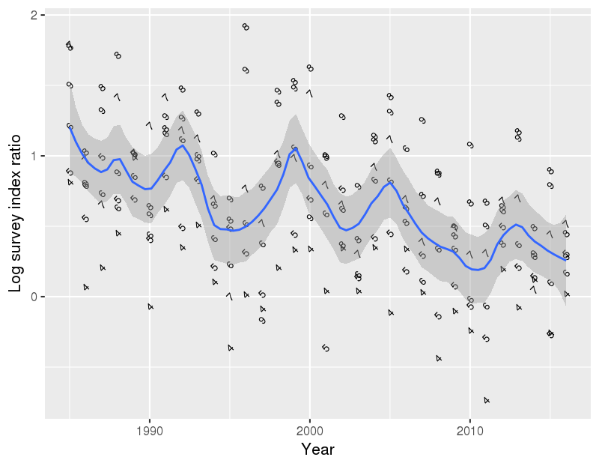
iCod: Log survey ratios by each age group

